Slide 1
GA PROFILES
Julie Carroll
Outcomes Lead, Boston
Notes:
What are Profiles? 20 mins (9:05-9:25)
Profiles Demo 5 mins (9:25-9:30)
Expectations: 5 mins (9:30-9:35)
Work on your Profile: 40+ mins (9:35-10:15)
Outcomes Assignment: 5 mins (10:15-10:20)
Final Outcomes Workshops: 5 mins (10:20-10:25)
End at 10:25

Slide 2
GA PROFILES
PORTFOLIO CRITIQUE

Slide 3
GA PROFILES
WHY DO I NEED A GA PROFILE?
I already have a LinkedIn, a resume, a portfolio, and a pretty face.

Slide 4
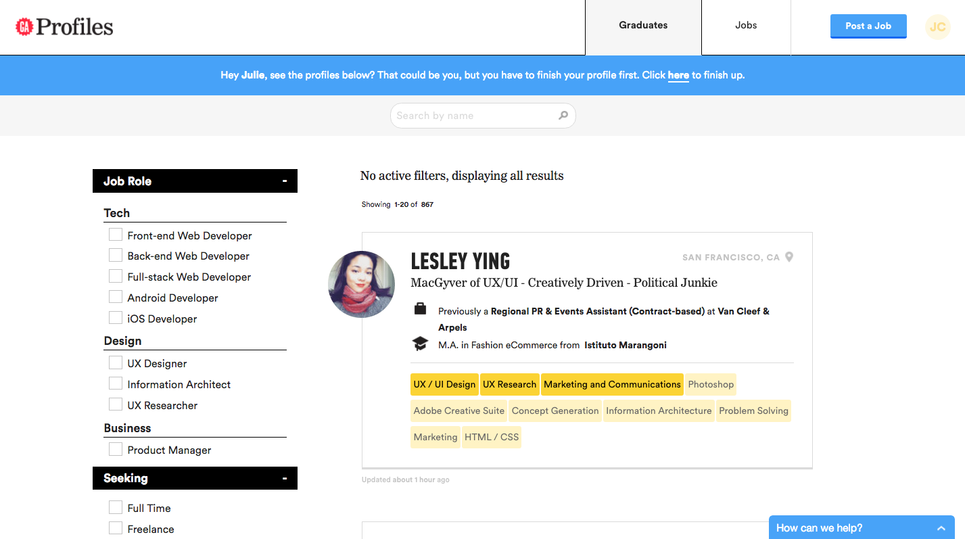
GA PROFILES
WHAT IS PROFILES?
Employer view:

Slide 5
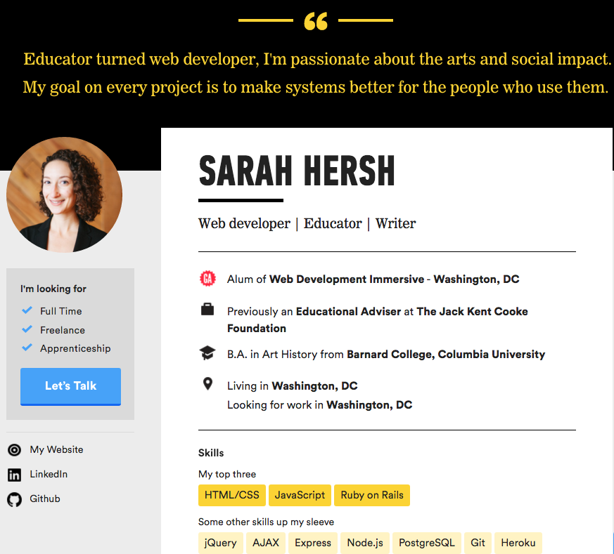
GA PROFILES
WHAT IS PROFILES?
Example profile:
(above the fold)
See more at
http://profiles.ga.co

Slide 6
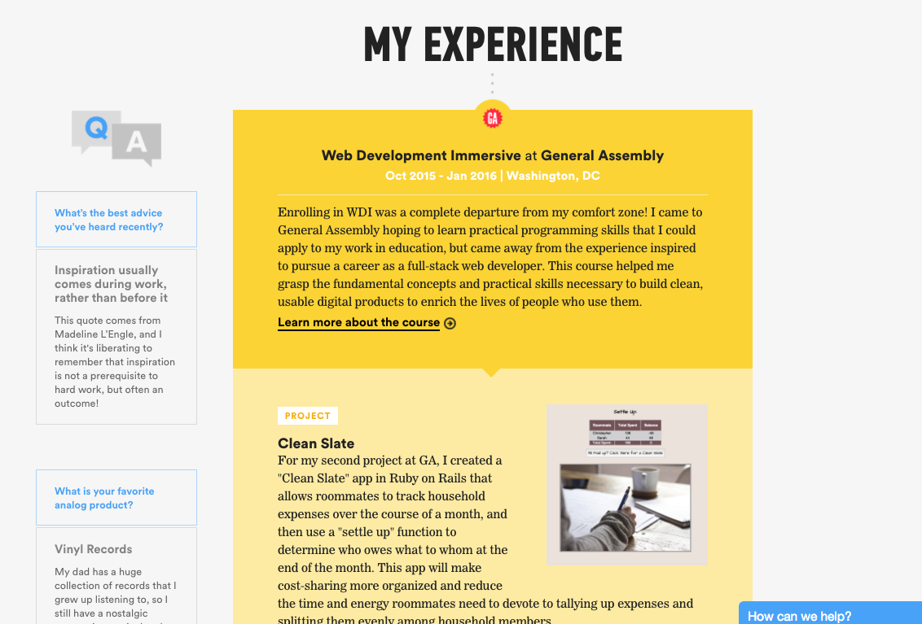
GA PROFILES
Profile
continued:

Slide 7
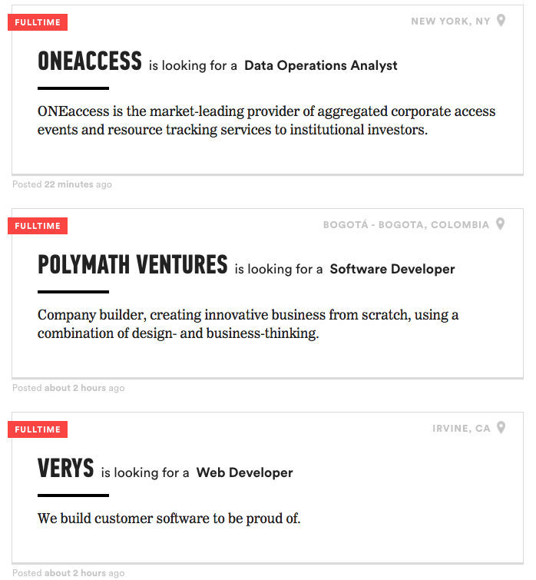
GA PROFILES
WHAT IS PROFILES?
Job board for GA alumni:

Slide 8
GA PROFILES
M+H BOOKLET EXAMPLE
Celena’s page
About Me: Summary
Education: GA Course details
Skills: Primary skills
The Basics: Web presence

Slide 9
EXPECTATIONS
EXPECTATIONS FOR GRADS
It is your responsibility to ensure content is accurate and updated.
Grads must respond to employer outreach within 24 - 48 hours whether you want the job opportunity or not.

Slide 10
GA PROFILES
CREATING YOUR PROFILE

Slide 11
CREATING A PROFILE
DO THIS FIRST you must login at [ www.generalassemb.ly ]
DO THIS NEXT in a NEW window or NEW tab, [ profiles.ga.co/profiles/new ]

Slide 12
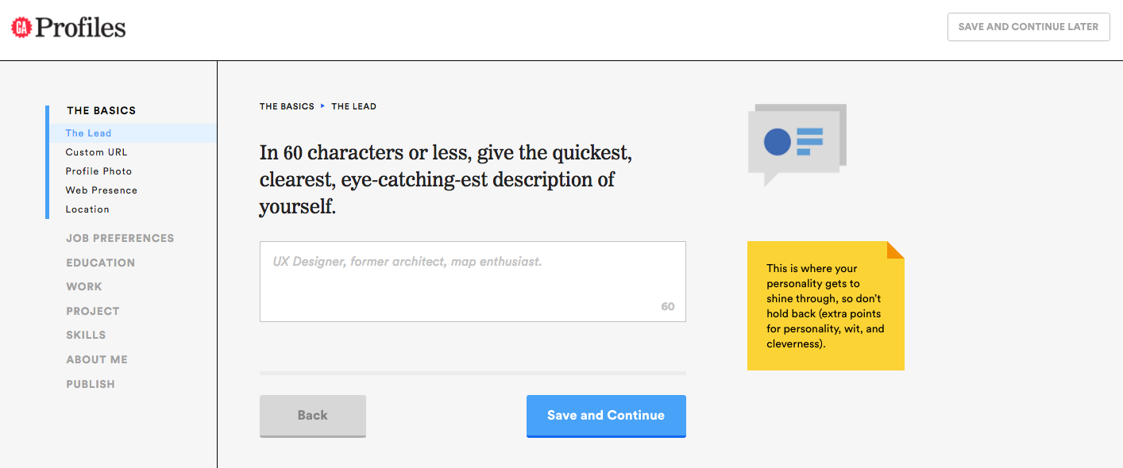
CREATING A PROFILE
BOOKMARK THIS PAGE: profiles.generalassemb.ly
“Save and continue” functionality → Use both buttons
Don’t use the nav bar – use the save buttons
Can’t log in? Try logging out and in again. Still can't? Try visiting http://ga.co/newprofile.

Slide 13
GA PROFILES
OUTCOMES ASSIGNMENTS

Slide 14
FINAL OUTCOMES ASSIGMENTS
ALL Outcomes Assignments
Attend final 1:1 (feedback will be given on all items below)
Before 1:1, complete:
Finalized resume
Finalized LinkedIn
Finalized Portfolio/Blog
Published GA Profile
Attend Meet & Hire
Begin job seeker requirements as of graduation
10 jobs per week; 1-2 Networking events/meetings per week; continued skill building; 25+ hours per week devoted to job search

Slide 15
GA PROFILES
IMPORTANT DATES

Slide 16
IMPORTANT DATES
Mark your calendars
Next week → Final Outcomes workshop on launching your job search
Week 12 and 13→ Final 1:1s
11/16 → Prep session for M & H
11/17 → Meet & Hire (new time)

